Slide 1
Bias vs. Variance

Slide 2
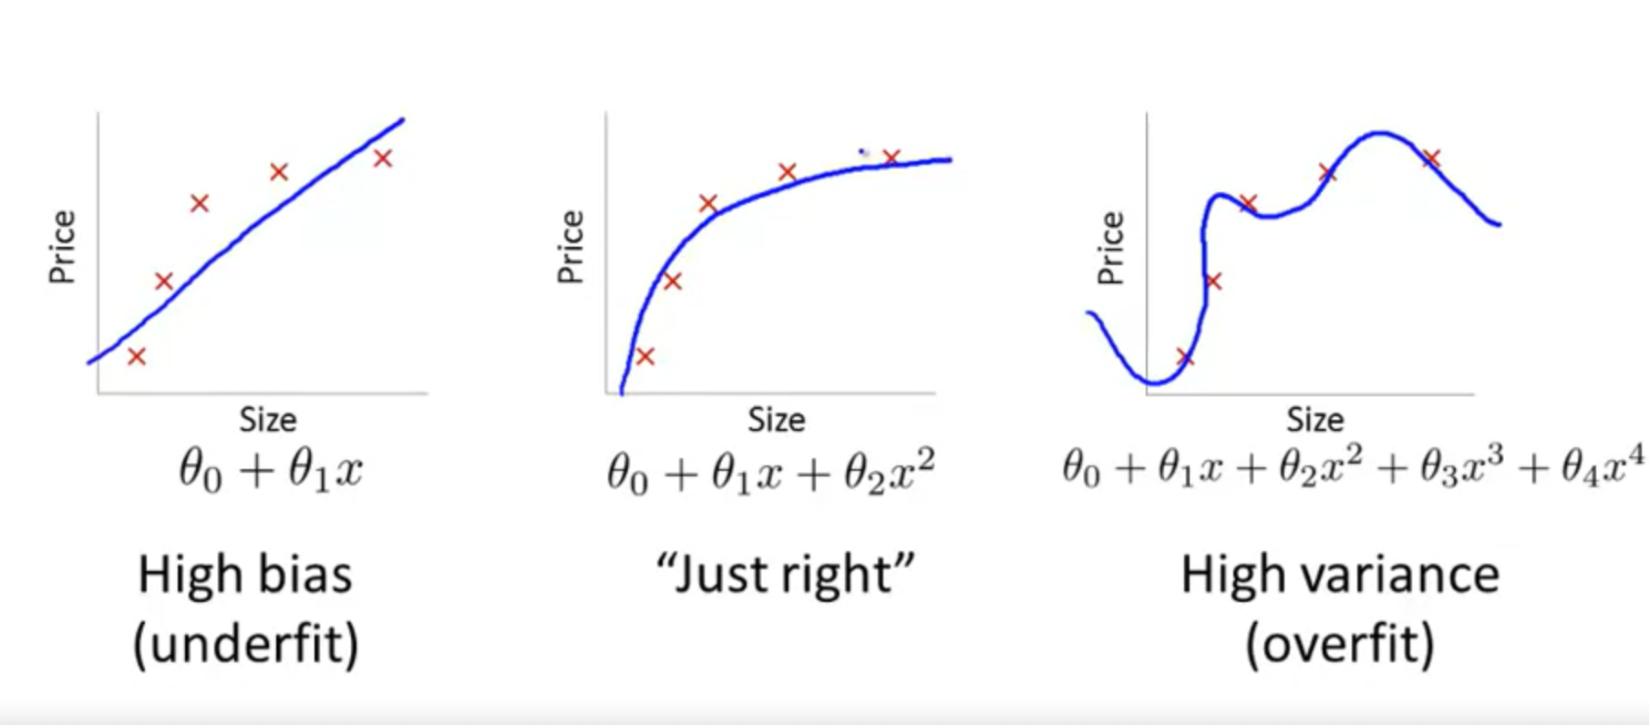
Diagnosing Bias vs. Variance

Slide 3
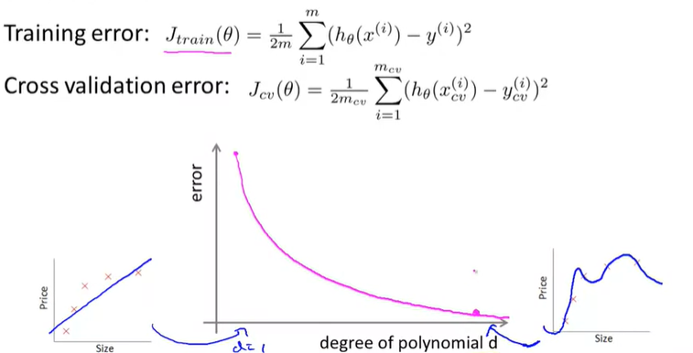
Diagnosing Bias vs. Variance
Bias
Variance

Slide 4
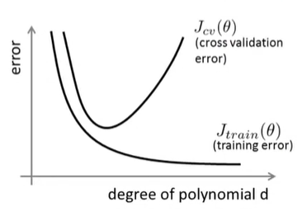
Diagnosing Bias vs. Variance
Bias (Underfitting):
High training error
High validation error
Variance (Overfitting):
Low training error
High validation Error
Bias
Variance

Slide 5
Learning Curves

Slide 6
Learning Curves

Slide 7
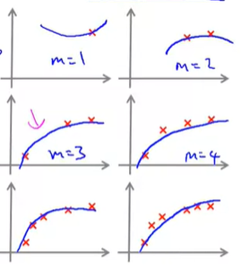
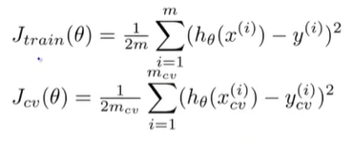
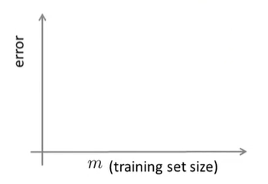


Learning Curves
Losses
More data => Harder to fit (overfit)

Slide 8
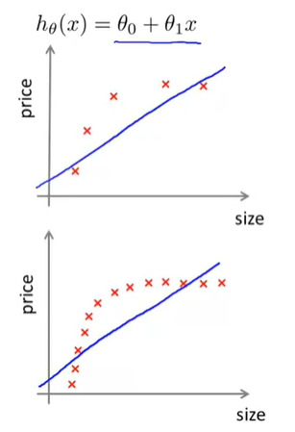
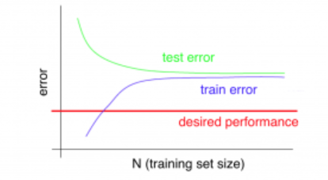
Learning Curves
High bias
More training data will not resolve high bias very much

Slide 9
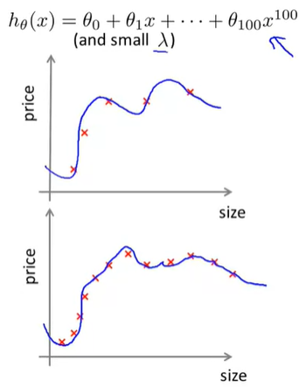
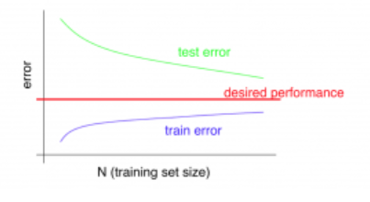
Learning Curves
High variance
Getting more training data might resolve high variance

